Slide 1
Welcome to the Qualtrics 2 Training Session!
Mark your attendance: go.illinois.edu/training_attendance
Please log into Qualtrics (illinois.qualtrics.com)
Create a new survey to try out the techniques we’ll be discussing
Be ready with questions or issues you may have with your existing surveys – we will have time to address them
Center for Innovation in Teaching & Learning (CITL)

Slide 2
Intermediate Qualtrics
Instructor: Nathan Jeffery
Center for Innovation in Teaching & Learning (CITL)
Last updated: 2026-02-18

Slide 3
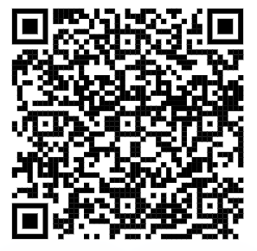
Request a consultation
Scan the QR code to submit a request or follow the link below.
Consulting is open to all University of Illinois students, faculty, and staff during the Fall, Spring and Summer 2 semesters.
People are encouraged to contact us for appointments by submitting a request. Drop-in questions during consulting hours are welcome either through Zoom during our virtual drop-in hours or in person at Scholarly Commons 220 Main library.
go.illinois.edu/requestconsult
Center for Innovation in Teaching & Learning (CITL)

Slide 4
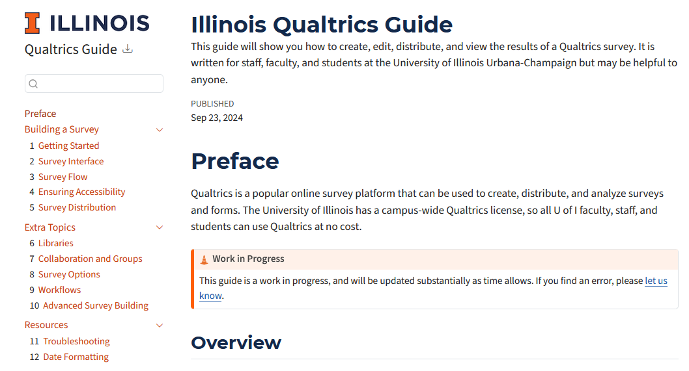
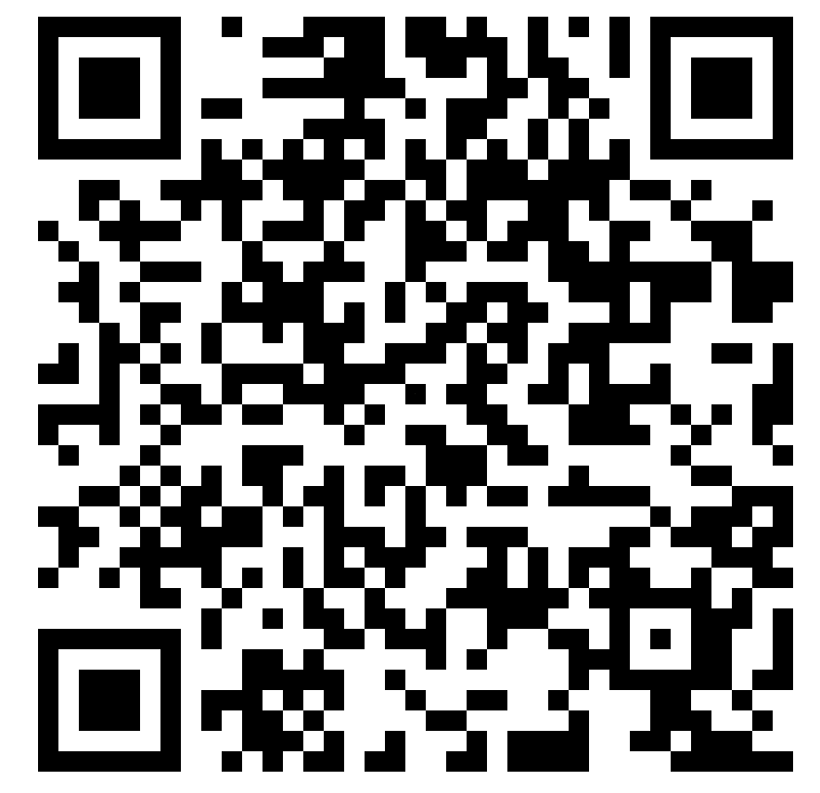
Campus Qualtrics Guide
Scan the QR code to access the guide or follow the link below.
go.illinois.edu/qualtricsguide
Center for Innovation in Teaching & Learning (CITL)

Slide 5
Agenda
Review: Getting informed consent and preventing spam
Writing good questions
Formatting your survey questions
  Rich Content Editor
  Piped Text
  Carry Forward
  Recode Values
Customizing the survey flow
Making your survey accessible
Distributing your survey
Viewing, analyzing, and exporting the responses to your survey
Center for Innovation in Teaching & Learning (CITL)

Slide 6
What do you want to discuss tonight?
Center for Innovation in Teaching & Learning (CITL)
6

Slide 7
Review: Security and Consent
Center for Innovation in Teaching & Learning (CITL)
7

Slide 8
Human Subjects Research & Consent
Be mindful when collecting personally identifiable information.
  What information do you need to collect?
  Who will have access to that information?
If your survey is for research, IRB protocol will likely apply
For research that involves participants located outside the US, check with the IRB office (OPRS) about GDPR and PIPL regulations
Center for Innovation in Teaching & Learning (CITL)

Slide 9
Fraud and Bot detection
The Issue
Preventative Measures
If your survey is publicly distributed, it’s possible that people will submit thousands of fake responses
The chance for fraud increases drastically if you offer money to respondents
AI-generated responses can be extremely hard to detect; in the worst scenario, you may have to throw out all the data you collected
Go to Survey Options > Security
  Turn on Bot detection
  Turn on Security scan monitor
Depending on your needs, you can change other settings
  Add a referral website URL
  Prevent or flag multiple submissions
  Password protection
  Etc.
Center for Innovation in Teaching & Learning (CITL)

Slide 10
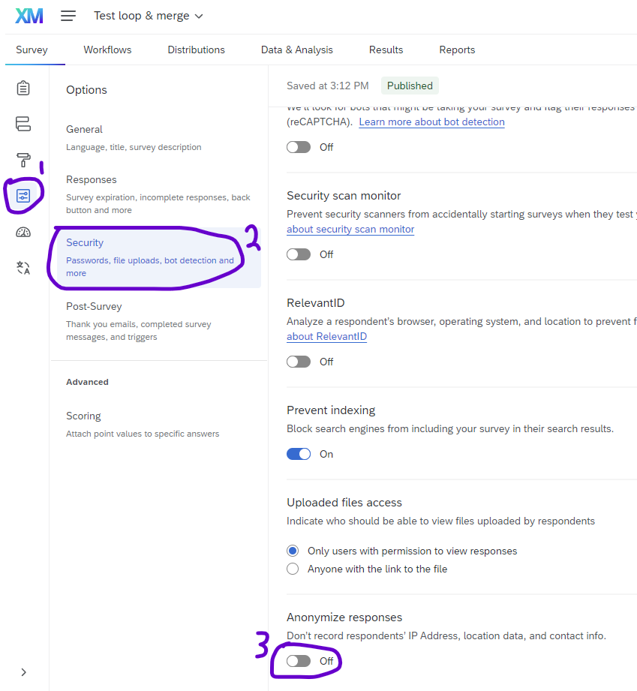
IP Address collection
Qualtrics collects respondents’ locations and IP addresses by default.
Often, you can tell respondents their responses are confidential and leave the default settings.
To make responses truly anonymous, go to Security under Survey Options.
Anonymous surveys cannot be used for longitudinal data collection.
Note: This setting is applied to each survey separately.
Center for Innovation in Teaching & Learning (CITL)

Slide 11
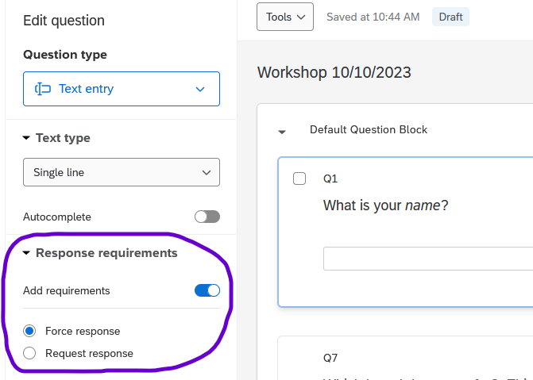
Force vs Request Response
You can force response in forms, but avoid it in surveys
In surveys, only force response to the consent question(s)
Center for Innovation in Teaching & Learning (CITL)

Slide 12
Question Design
How do people answer questions?
What is satisficing? How do I avoid it?
When should I use open-ended and multiple-choice questions?
Center for Innovation in Teaching & Learning (CITL)
12

Slide 13
A Theory of Question Answering (1)
Cognitive Steps to Answering a Survey Question
  Interpret the meaning of the question
  Retrieve the relevant information from memory
  Form a judgment based upon that information
  Select a response from the available options
When all steps are used, this is called “optimizing”
Center for Innovation in Teaching & Learning (CITL)

Slide 14
A Theory of Question Answering (2)
Example: How do you feel about ability to handle your workload this semester?
  Extremely confident
  Very confident
  Somewhat confident
  Not very confident
  Not at all confident
Center for Innovation in Teaching & Learning (CITL)

Slide 15
A Theory of Question Answering (3)
Cognitive Steps to Answering a Survey Question
  Interpret the meaning of the question
  Retrieve the relevant information from memory
  Form a judgment based upon that information
  Select a response from the available options
When steps are skipped, this is called “satisficing”
Center for Innovation in Teaching & Learning (CITL)

Slide 16
A Theory of Question Answering (4)
Example: How many books do you own?
  Zero
  Between 1 and 10
  Between 11 and 20
  Between 21 and 30
  Between 31 and 40
  More than 40
Center for Innovation in Teaching & Learning (CITL)

Slide 17
Satisficing (1)
Satisficing means:
  choosing a plausible answer that would be easy to justify without thinking
Center for Innovation in Teaching & Learning (CITL)

Slide 18
Satisficing (2)
Examples:
  Choosing the first response that looks reasonable
  Choosing a response at random
  Choosing a socially desirable response
  Saying “I don’t know”
Center for Innovation in Teaching & Learning (CITL)

Slide 19
Satisficing (3)
Why do people satisfice?
  Lack of ability
  Lack of motivation
  Task difficulty
Center for Innovation in Teaching & Learning (CITL)

Slide 20
How do we minimize satisficing? (1)
Maximize their ability to respond
  Use language appropriate for the audience
  Ask about topics they are familiar with
Maximize their motivation
  Describe the purpose and value of the survey
  Keep the survey short
Center for Innovation in Teaching & Learning (CITL)

Slide 21
How do we minimize satisficing?(2)
Minimize task difficulty
  Minimize the number of words in questions
  Use familiar words at an “easy” reading level
  Focus on current or very recent events
  Ask about one topic per question
  Use survey logic when possible (branch, display, skip)
  Use verbal labels on scale points instead of numbers
  Avoid agree/disagree, true/false, yes/no questions
Center for Innovation in Teaching & Learning (CITL)

Slide 22
Open-ended Questions
If you want a numeric answer
  “On average, how many days per week do you work from home?”
  You can use validation to ensure that only numeric answers are provided
When you can’t list all possible answers
  If you want to know why things happen, use open-ended, not a multiple choice with “other – please specify”
    People don’t often “specify”
    The list of answers you provide limits the kind of answer they will give
Center for Innovation in Teaching & Learning (CITL)

Slide 23
Item-specific vs agree-disagree questions (1)
Some research suggests item-specific questions yield better data than agree-disagree questions
Why do people use agree-disagree questions?
  Easy to write
  Easy to copy them from other surveys
  Easy to ask about unrelated topics with the same scale
Center for Innovation in Teaching & Learning (CITL)

Slide 24
Why might you want to avoid agree-disagree questions?
People are prone to acquiescence bias – to say “agree” without thinking
  This tendency varies across demographic groups
Less statistically reliable
Difficult to interpret “disagree” responses
Center for Innovation in Teaching & Learning (CITL)

Slide 25
Item-specific Questions
Instead of …
My IT professional is very helpful.
  Strongly Disagree
  Disagree
  Neither agree nor disagree
  Agree
  Strongly Agree
Consider …
How helpful is your IT professional?
  Extremely helpful
  Very helpful
  Moderately helpful
  Slightly helpful
  Not helpful at all
Center for Innovation in Teaching & Learning (CITL)
Notes:
Try it: Does your (existing) survey have any questions you’re thinking about rewriting?
Let’s crowd-source some ideas

Slide 26
Question Formatting
Rich Content Editor
Piped Text
Carry Forward
Recode Values
Center for Innovation in Teaching & Learning (CITL)
26

Slide 27
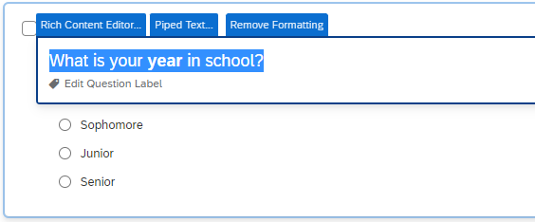
Rich Content Editor
Center for Innovation in Teaching & Learning (CITL)
Notes:
Try it:
Create a question and format it
Add an image to a question

Slide 28
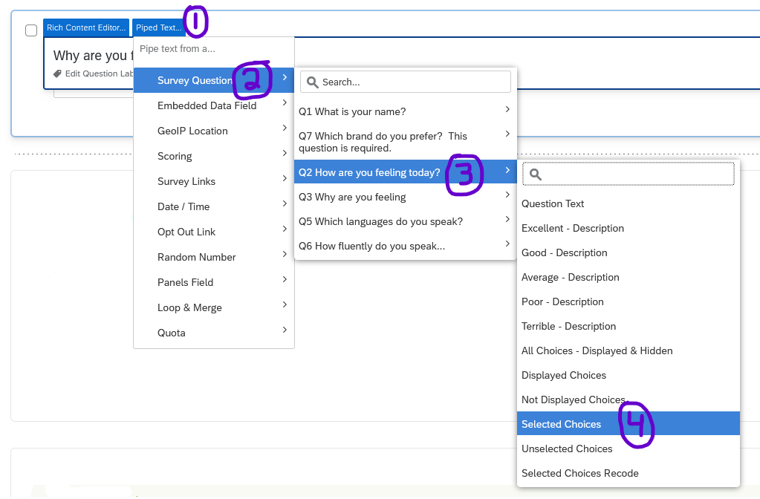
Piped Text (1)
Center for Innovation in Teaching & Learning (CITL)

Slide 29
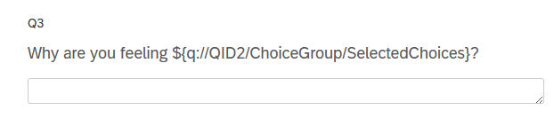
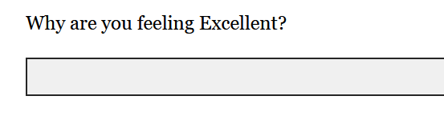
Piped Text (2)
Preview the survey to see how it will look.
Add a page break if you’re piping text from a previous question
Center for Innovation in Teaching & Learning (CITL)
Notes:
Try it:
Make a MC question
Pipe the answer into a follow-up short-answer question

Slide 30
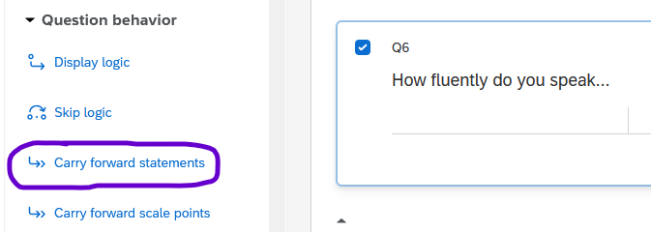
Carry Forward (1)
Center for Innovation in Teaching & Learning (CITL)

Slide 31
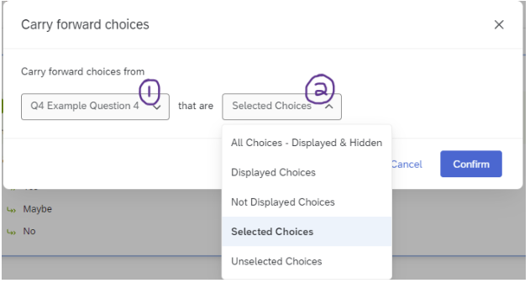
Carry Forward (2)
Note: Insert a page break between the two questions
Center for Innovation in Teaching & Learning (CITL)
Notes:
Try it:
Make a ‘language’ or ‘games you have played’ etc. question
Ask a follow-up question about it using carry forward

Slide 32
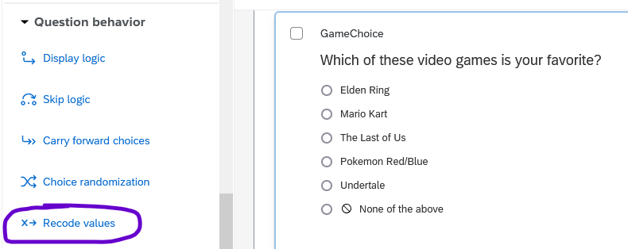
Recode Values (1)
Center for Innovation in Teaching & Learning (CITL)

Slide 33
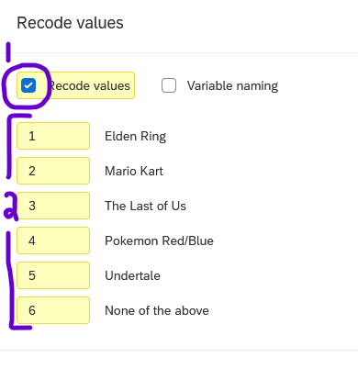
Recode Values (2)
If you have not enabled recode values, avoid downloading the data as numeric. Qualtrics assigns values by default, but its default choices are unhelpful!
Center for Innovation in Teaching & Learning (CITL)
Notes:
Try it:
Make a ‘language’ or ‘games you have played’ etc. question
Ask a follow-up question about it using carry forward

Slide 34
Accessibility
Center for Innovation in Teaching & Learning (CITL)
34

Slide 35
Accessibility: Main Points
Use the “New survey taking experience”
Images need alt text; audio needs captions
Indicate where you use validation
  e.g., “Enter a whole number between 1 and 50”
If you modify color or font size, check readability and contrast
Center for Innovation in Teaching & Learning (CITL)

Slide 36
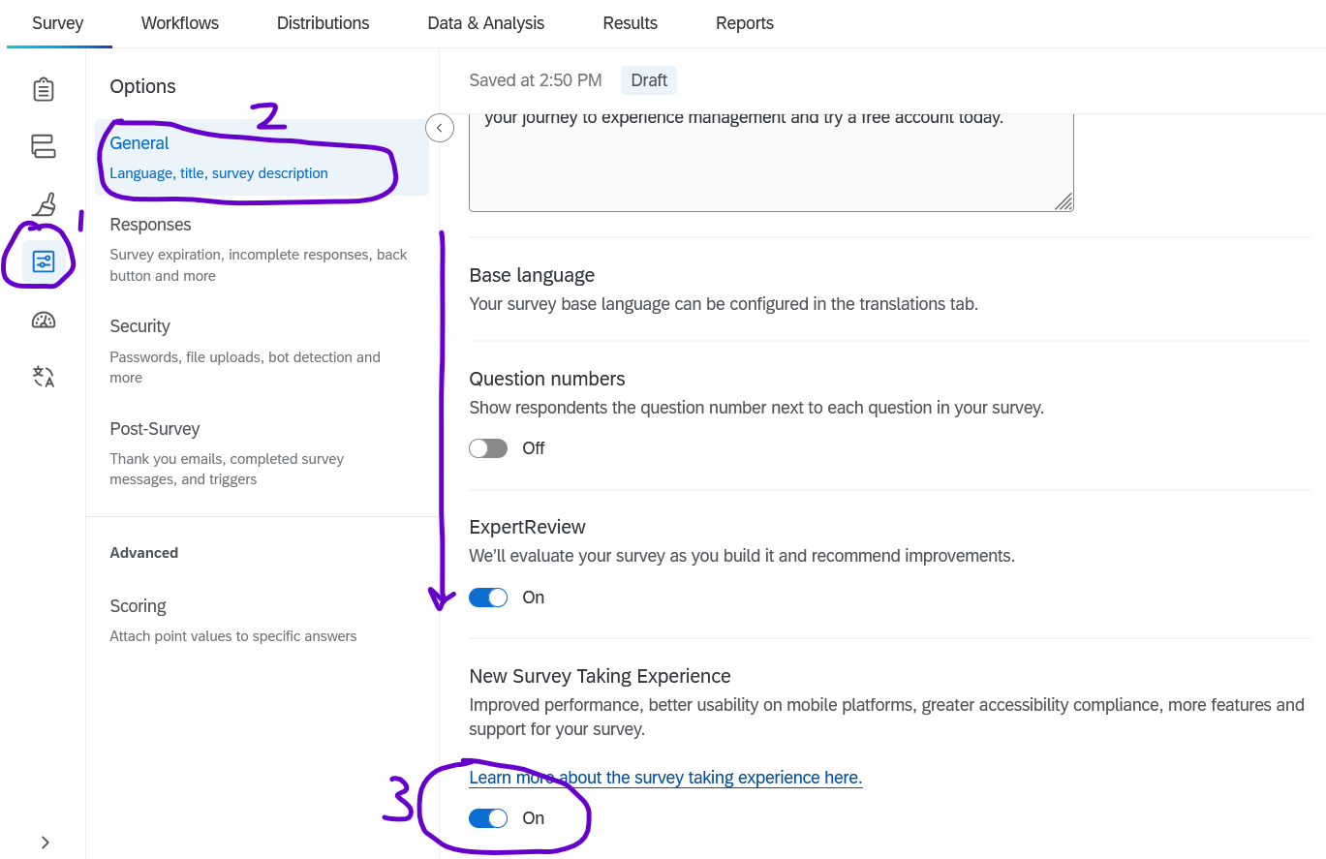
New Survey Taking Experience
In the future, this may be enabled by default.
For now: Enable it for each survey.
Center for Innovation in Teaching & Learning (CITL)

Slide 37
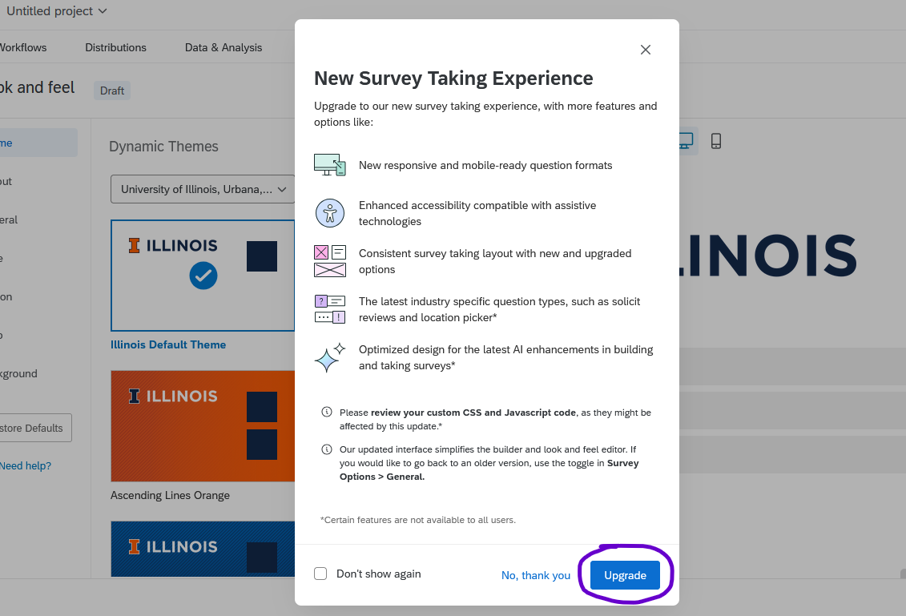
Accessibility: Enable the “New Survey Taking Experience”
The New survey taking experience is an option you can enable in the Look and feel or Survey options tabs.
It improves the user interface for all survey-takers
Questions better meet accessibility guidelines and are optimized for mobile and PC users
Center for Innovation in Teaching & Learning (CITL)

Slide 38
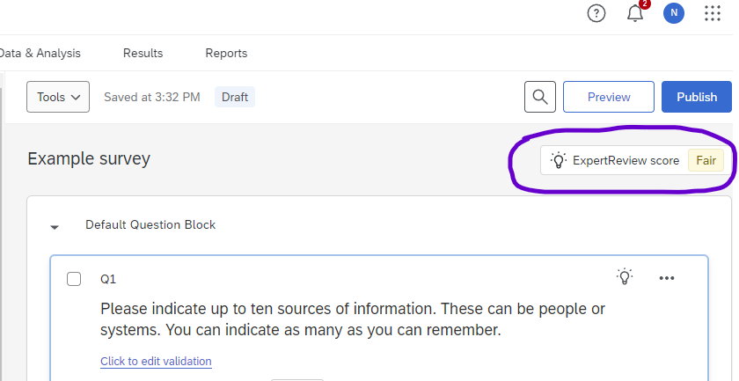
Accessibility: ExpertReview can also be useful
ExpertReview is available for all surveys
It includes suggestions about accessibility as well as survey length, logic, and more
You can access it in the top-right corner of the survey editor, under Preview and Publish
Center for Innovation in Teaching & Learning (CITL)
Notes:
Try it: What does ExpertReview say about your survey right now?

Slide 39
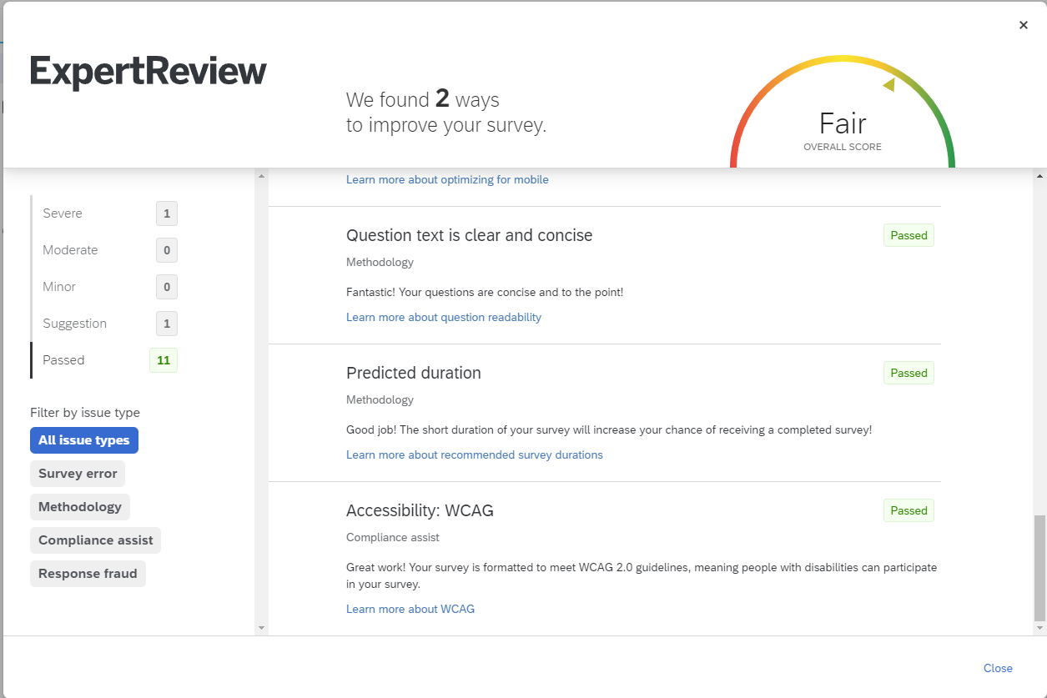
Accessibility: Limitations of ExpertReview
ExpertReview does NOT check
alt text, color, font size …
So, it can be helpful, but you will still have to check some things yourself
Remember, you are the final judge of what to include in your survey
Center for Innovation in Teaching & Learning (CITL)
Notes:
Try it: What does ExpertReview say about your survey right now?

Slide 40
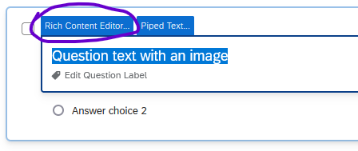
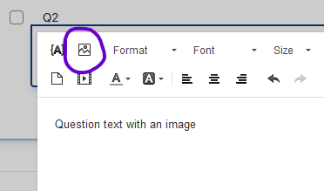
Accessibility: Alt text (1)
To add an image, DON’T use “Add graphic.” (It doesn’t provide alt text options.)
Instead, add text
Then open the Rich Content Editor and click the image icon to add the image
See also: Qualtrics documentation on Image Properties
Center for Innovation in Teaching & Learning (CITL)
Notes:
Try it with the image you inserted

Slide 41
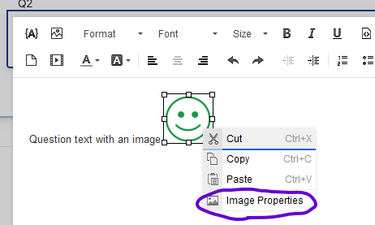
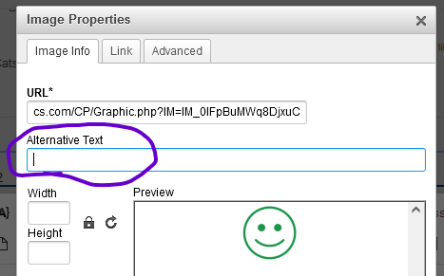
Accessibility: Alt text (2)
When the image appears, right-click it and choose Image Properties
Add the alt text to the field and click OK
Center for Innovation in Teaching & Learning (CITL)

Slide 42
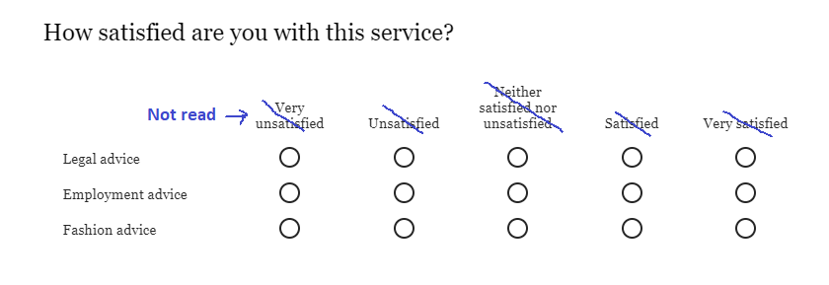
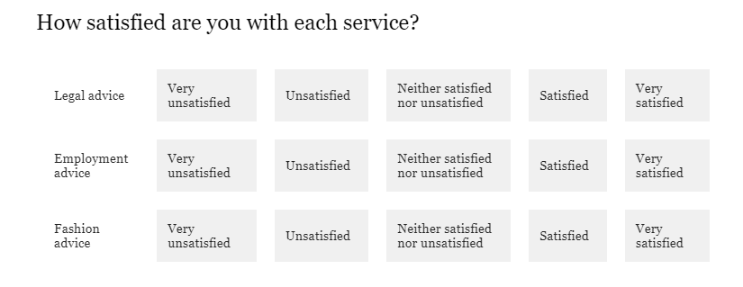
Matrix questions
The Problem
If you don’t use the New survey experience, matrix questions will not be accessible.
Screen readers cannot read column headings, so users won’t know the scale points.
Solutions
Use the New Survey experience
OR: In the Question editing pane on the left, scroll to “Format” and change from “Standard likert” to “Profile.”
See also: Qualtrics documentation on Question Type Accessibility
Center for Innovation in Teaching & Learning (CITL)
Notes:
Try it: change to Profile view

Slide 43
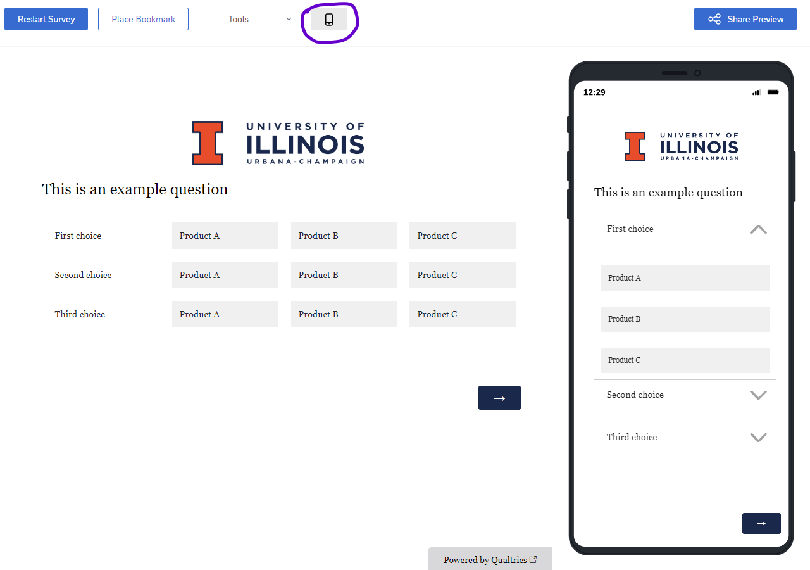
Mobile Accessibility
Most question types are mobile-friendly or have a (default) option to be mobile friendly
Preview your survey
Matrix questions often change to drop-downs
See also: Qualtrics documentation on Mobile Optimization
Center for Innovation in Teaching & Learning (CITL)

Slide 44
Survey Flow
Embedded Data
Branch Logic
Authentication
Center for Innovation in Teaching & Learning (CITL)
44

Slide 45
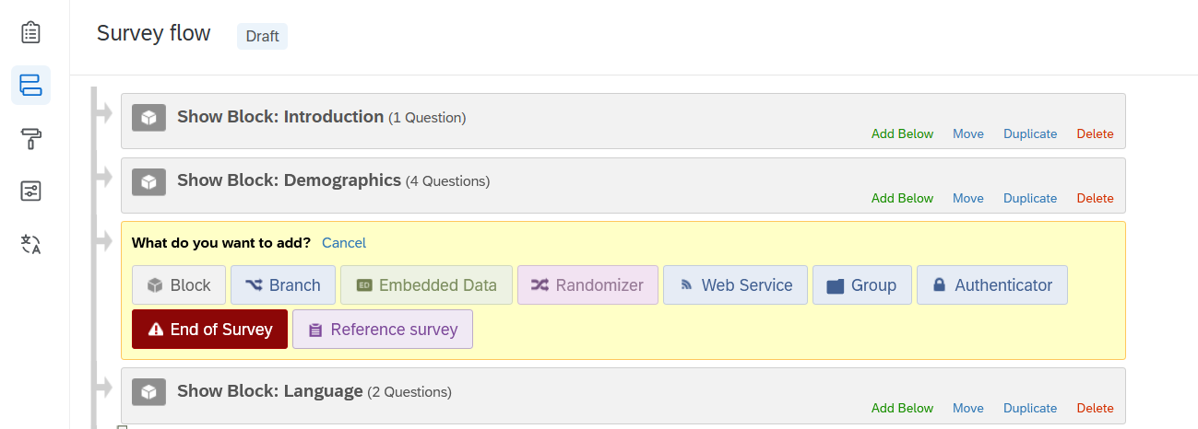
Survey Flow (Review)
Center for Innovation in Teaching & Learning (CITL)

Slide 46
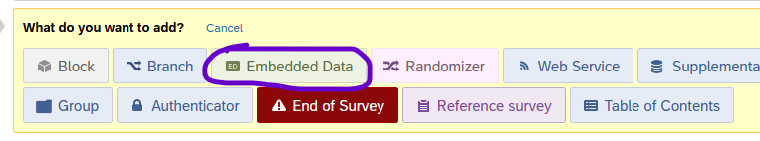
Survey Logic: Embedded Data
Can include:
Piped Text from a survey question
Random numbers (for anonymous research)
Respondent’s location
Query strings (discussed later)
Center for Innovation in Teaching & Learning (CITL)

Slide 47
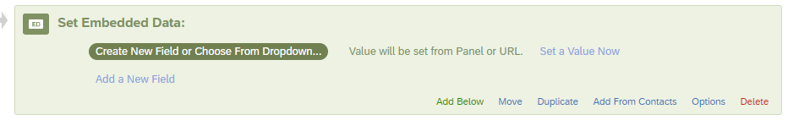
Embedded Data
Center for Innovation in Teaching & Learning (CITL)

Slide 48
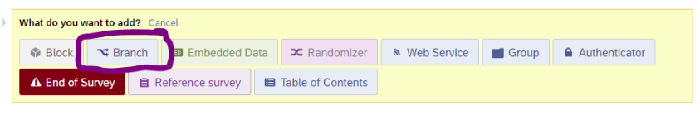
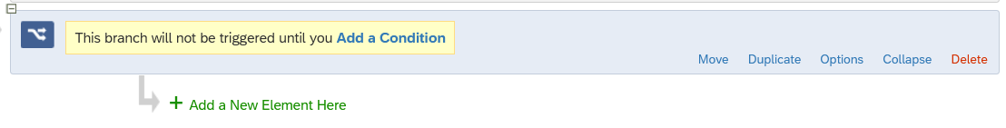
Survey Logic: Branching
Center for Innovation in Teaching & Learning (CITL)

Slide 49
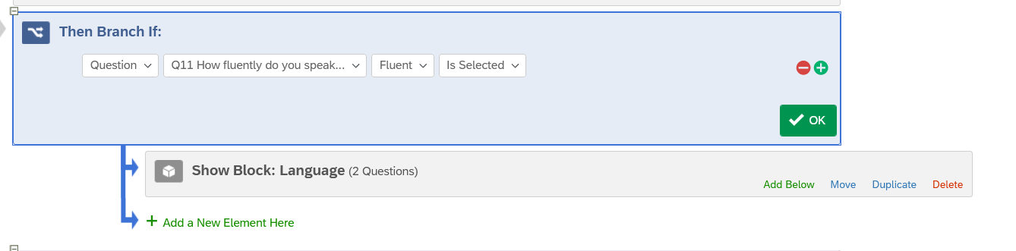
Branching
Center for Innovation in Teaching & Learning (CITL)

Slide 50
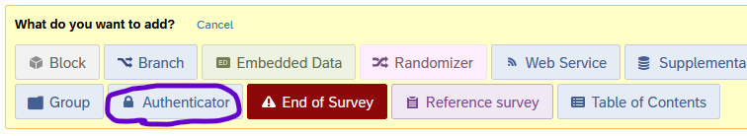
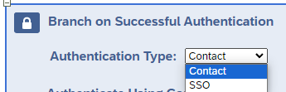
Survey Logic: Authentication
Note: There are more authentication options than we can cover today. For more details, see the Qualtrics documentation on Authenticators
Center for Innovation in Teaching & Learning (CITL)

Slide 51
Authentication Options
SSO:
Short for “Single Sign-On,”
One account that lets you log in multiple places
Examples include:
  Shibboleth (i.e., UIUC NetID)
  Google
  Facebook
Contact list:
You can upload a list with email addresses, names, and other data fields (discussed in a minute).
Then, you can authenticate based on the person’s Email or an External Data Reference (i.e., a password you assign them)
Center for Innovation in Teaching & Learning (CITL)

Slide 52
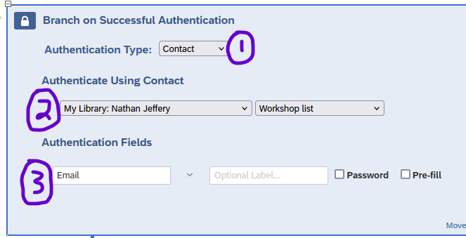
Authentication (Contact)
Center for Innovation in Teaching & Learning (CITL)

Slide 53
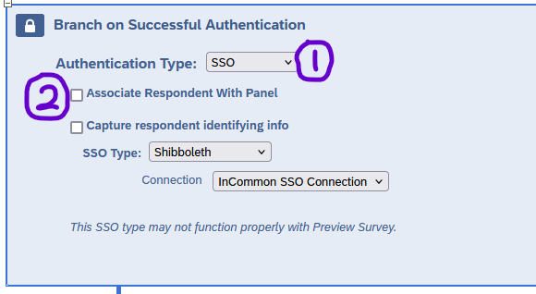
Authentication (SSO)
Center for Innovation in Teaching & Learning (CITL)

Slide 54
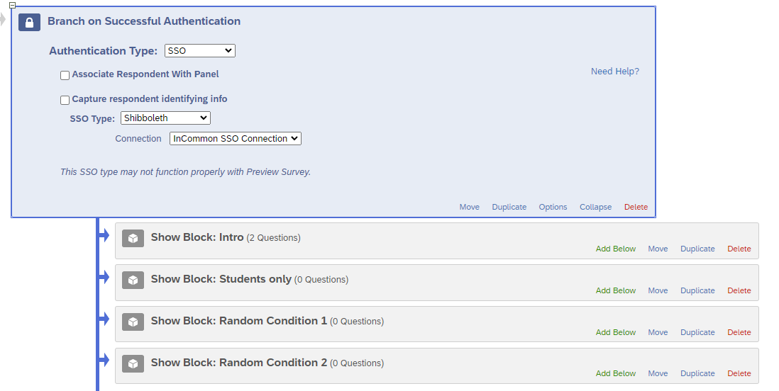
Authentication (Final steps)
Move the survey blocks that you want authenticated (Usually the whole survey) underneath the authenticator
Center for Innovation in Teaching & Learning (CITL)

Slide 55
Survey Distribution
Webtools
Contact lists
Center for Innovation in Teaching & Learning (CITL)
55

Slide 56
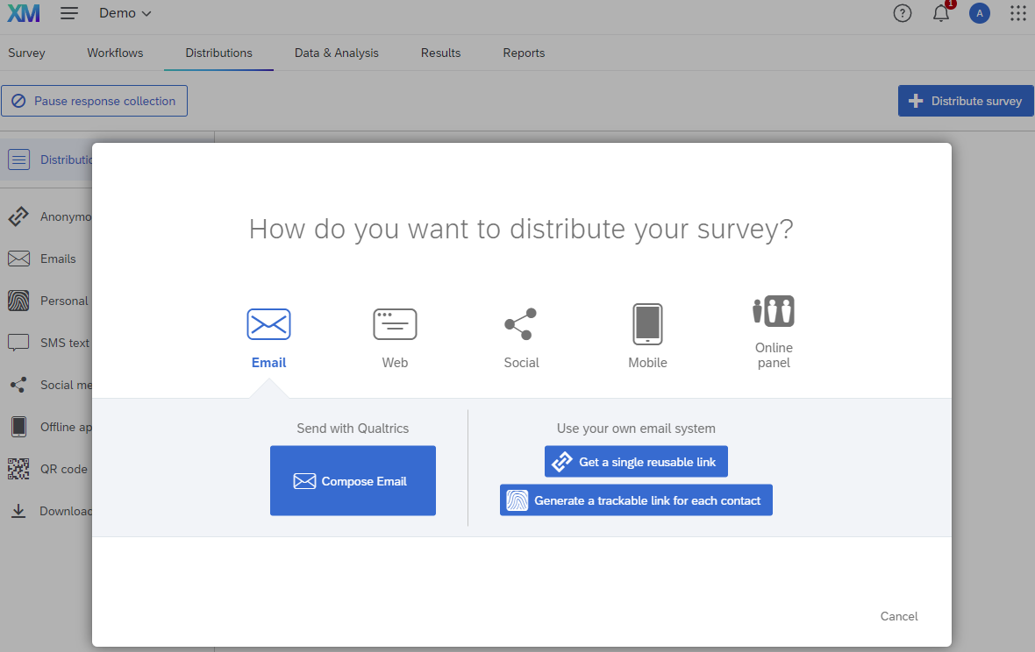
Distribution: Review
Center for Innovation in Teaching & Learning (CITL)

Slide 57
Webtools Distribution
(“go-links”)
Create a stable link for your surveys using Webtools
  Visit webtools.illinois.edu
  Available to graduate students, faculty, staff
  Undergrad or don’t have access? Ask your advisor
Lets you publish one URL, then change the survey it connects to
  Useful for multi-semester projects
Center for Innovation in Teaching & Learning (CITL)

Slide 58
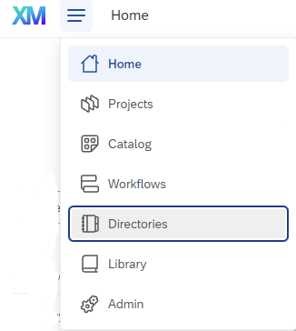
Contact Lists: Overview
You can use contact lists (aka directories) to:
  Distribute a survey using personalized links
    You can distribute to the whole list or to a sample of people on it
  Authenticate respondents
  Embed data (name, etc.) in the survey or in the response data
  Send a follow-up email (workflow)
Center for Innovation in Teaching & Learning (CITL)

Slide 59
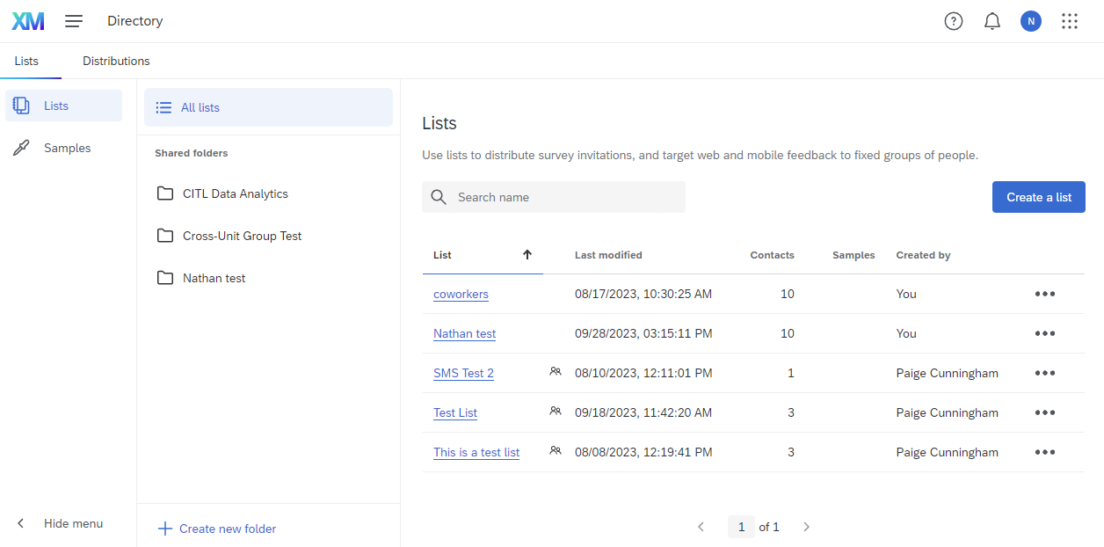
The Directories Tab
Your lists appear here
Create a new list here
You can organize your contact lists into folders
Center for Innovation in Teaching & Learning (CITL)

Slide 60
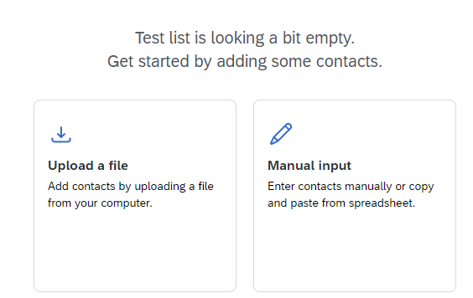
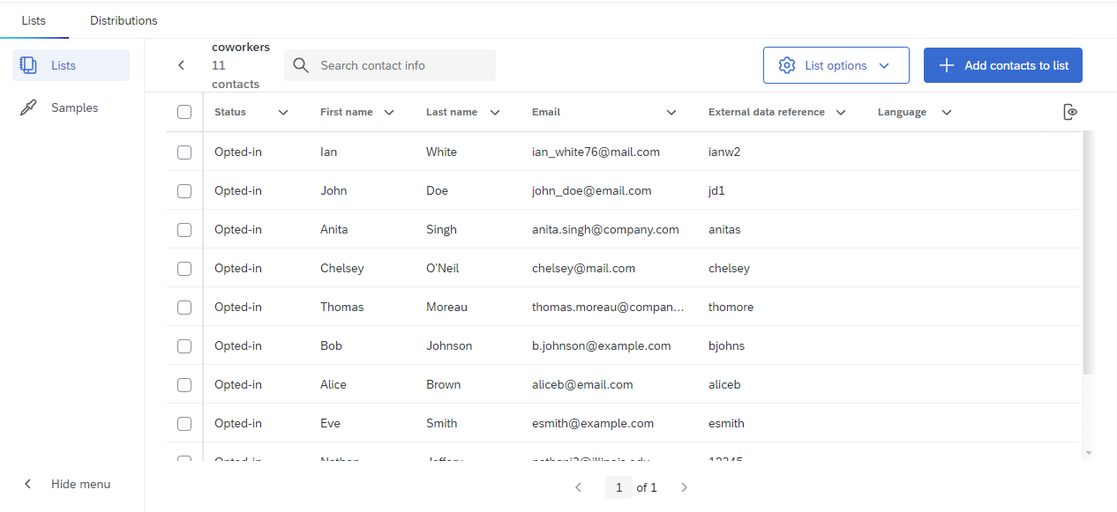
Creating a Contact List
This is how the contact list will appear once it’s entered
You can add contacts by uploading a file or imputing them manually
Center for Innovation in Teaching & Learning (CITL)

Slide 61
SMS Distribution
SMS is available, but credits must be purchased from WebStore.
SMS distribution allows you to:
  Text survey links to respondents (“one-way” communication)
  Receive survey responses via text (“two-way” communication)
    Limited question types are supported
    Two-way uses more credits than one-way
Pricing: $550 for 50,000 credits
  Purchase via Webstore
For more details, see the Qualtrics documentation on SMS Distribution
Center for Innovation in Teaching & Learning (CITL)

Slide 62
Analyzing Survey Data
Data & Analysis Tab
Exporting Data
Stats IQ (etc.)
Results and Reports
Center for Innovation in Teaching & Learning (CITL)
62

Slide 63
The Data & Analysis Tab
The Data & Analysis tab lets you:
  See survey responses
  Export responses to Excel, CSV, SPSS, etc.
  Apply filters to only see or export certain responses
    i.e., filter out survey previews
  Perform data analysis in Text IQ, Stats IQ, or Crosstab IQ
    Text IQ: Analyze text by assigning themes
    Stats IQ: Perform statistical analyses like correlations and linear regressions
    Crosstabs IQ: Perform cross-tabulations, i.e. to see responses broken down by race and gender
    Note: Your mileage may vary! These tools do not always provide the most reliable results.
    More details are available in our Qualtrics Guide (go.Illinois.edu/qualtricsguide)
Center for Innovation in Teaching & Learning (CITL)

Slide 64
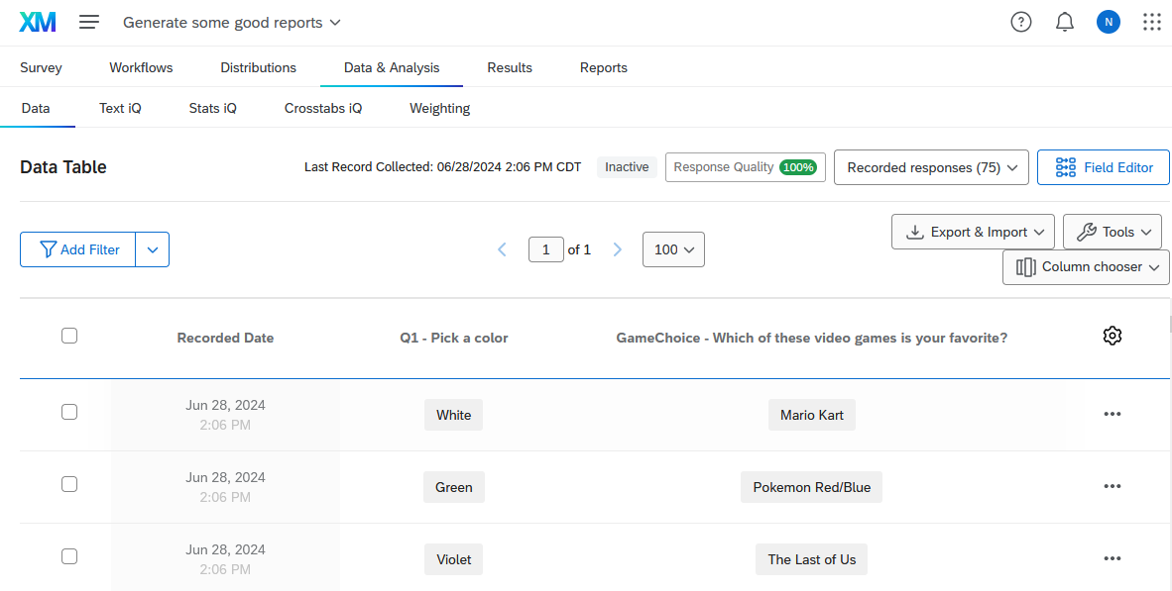
Data Table
Export data
(most useful)
Filter out certain responses
Choose which columns are visible
Edit or delete individual responses
Center for Innovation in Teaching & Learning (CITL)

Slide 65
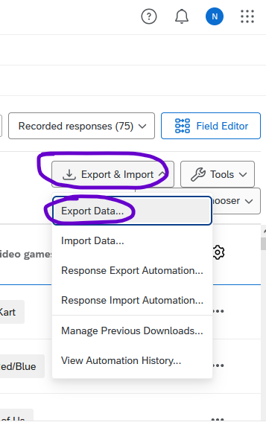
Exporting Data (1)
Click Export & Import
Then click Export Data
Center for Innovation in Teaching & Learning (CITL)

Slide 66
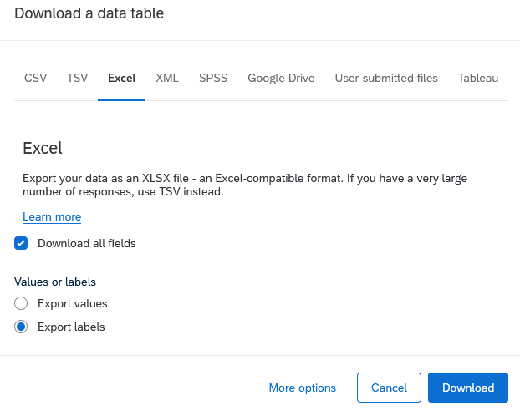
Exporting Data (2)
3. Choose your file format at the top
4. (with some formats)
Choose whether to export the values or labels
Choose Labels if you have not set recode values!
5. Click More options
Center for Innovation in Teaching & Learning (CITL)

Slide 67
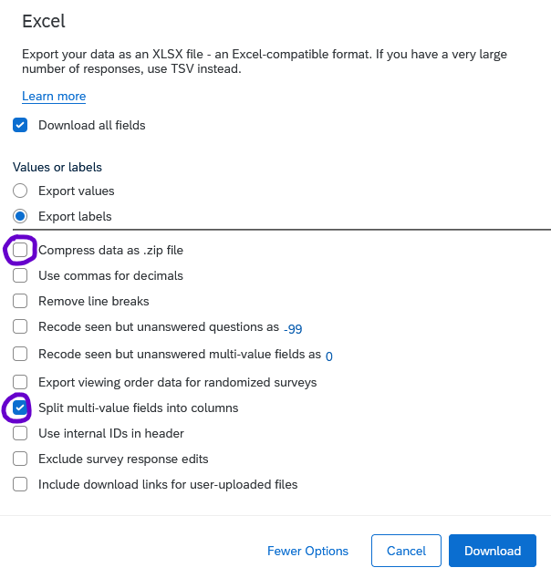
Exporting Data (3)
6. Select the appropriate options. We recommend (for most projects):
Uncheck “Compress data as .zip file”
because the files aren’t that big and unzipping them is a hassle.
(Unless you have millions of responses)
Check “Split multi-value fields into columns”
because it makes it easier to analyze check-all-that-apply questions
7. Click Download
Center for Innovation in Teaching & Learning (CITL)

Slide 68
Stats IQ
StatsIQ lets you perform statistical analyses on your data
In many cases, we recommend exporting the data and analyzing it with statistical software (i.e., SPSS, R, Stata, Python, etc.) instead of using Stats IQ
  Stats IQ is not always clear what procedure it performs
  Stats IQ defaults to some procedures that are not standard
    Linear regression: Johnson’s relative weights instead of ordinary least squares
    Linear regression: Missing data is imputed using the mean or median
For more details, see the Qualtrics documentation on Stats IQ and Statistical Test Assumptions
Center for Innovation in Teaching & Learning (CITL)

Slide 69
Results and Reports in Qualtrics
The Results tab shows auto-generated tables and graphs for each question in the survey
In the Reports tab, you can create shareable reports from scratch using the built-in (and sometimes unintuitive) interface
For simpler projects, these results/reports may be sufficient
For more involved projects, we recommend exporting the data and creating graphs in Excel, SPSS, R, Tableau, etc.
Center for Innovation in Teaching & Learning (CITL)

Slide 70
Thank you!
Nathan Jeffery
nathanj3@illinois.edu
Please complete the feedback survey in your email.
Center for Innovation in Teaching & Learning (CITL)

